Slide 1

A Photograph
By Shirley Toulson

Slide 2
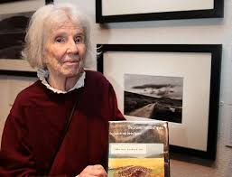
About the Poet
Shirley Toulson was born on 20th May 1924 in Henley-on-Thames, England as the daughter of Douglas Horsfall Dixon and Marjorie Brown. She had a huge passion for writing and was greatly influenced by her father who was a writer too. She studied B.A (Literature) from Brockenhurst College in London in the year 1953. Shortly, she took writing as career but also served as the editor for many magazines in meantime.

Slide 3
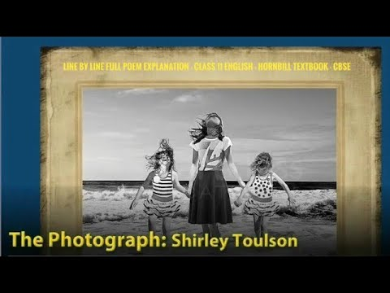
Introduction
The poem ‘A Photograph’ is written by Shirley Toulson. In this poem, she recalls her mother and her memories while looking at a childhood photograph when her mother was twelve years old or so. She cannot explain her grief on her mother’s loss.

Slide 4
Vocabulary
Paddling – walking
Transient – short-term; temporary
Snapshot – photograph
Literary Devices:
Alliteration - repetition of a consonant sound at the beginning of two or more consecutive words. The instances of alliteration in the poem are as follows– Stood still, Through their, My mother’s
Epithet - a phrase expressing a quality of a person or something
- Terribly transient
Oxymoron - a term which contradicts itself - Laboured ease

Slide 5
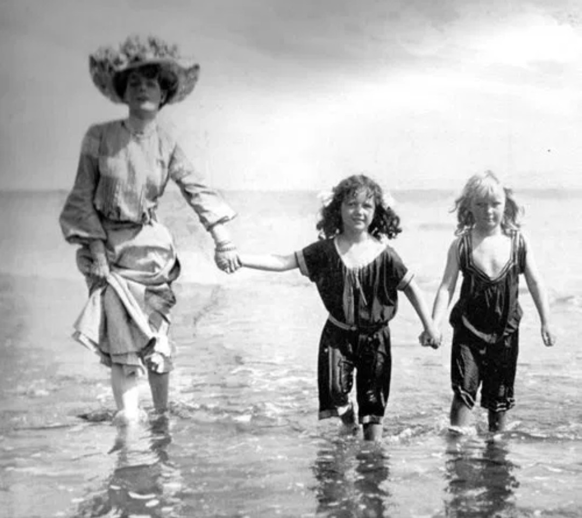
A Photograph (Poem)
The cardboard shows me how it was
When the two girl cousins went paddling,
Each one holding one of my mother’s hands,
And she the big girl — some twelve years or so.
All three stood still to smile through their hair
At the uncle with the camera. A sweet face,
My mother’s, that was before I was born.
And the sea, which appears to have changed less,
Washed their terribly transient feet.

Slide 6
Some twenty — thirty — years later
She’d laugh at the snapshot. “See Betty
And Dolly,” she’d say, “and look how they
Dressed us for the beach.” The sea holiday
Was her past, mine is her laughter. Both wry
With the laboured ease of loss.
Now she’s been dead nearly as many years
As that girl lived. And of this circumstance
There is nothing to say at all.
Its silence silences.

Slide 7
Gist:
The poem is a tribute to the poet’s mother. She is looking at an old photograph of her mother which has a frame of cardboard. The picture has three girls in which the middle one is the oldest and tallest.
It is her mother when she was twelve years old or so. Beside her, on both sides are her two cousins, Betty and Dolly, who are holding her hands and are younger than her. They went for paddling on a beach holiday. Her uncle took the photograph then. The poet could not help but notice her mother’s sweet face. The sea touched her terribly transient feet which depicted that she changed over the years and the sea remained the same.
After twenty-thirty years, her mother would laugh at the photograph. She would make the poet look at the photograph and tell her how their parents would dress them up for the beach holiday. The beach holiday was her mother’s favourite past memories while her laugh was the poet's favourite memory. Both of them lost something which they cherished a lot and yet cannot live that moment again. Those sweet moments were memories now.
Now, the poet’s mother had been dead for the past twelve years, which is the same number as of her age when the photograph was taken back then. She cannot express the grief that she has from her mother’s absence.

Slide 8
Useful Links:
https://www.youtube.com/watch?v=_SDMqkC13Qc
https://academicseasy.com/2013/12/class-xi-hornbill-photograph.html
http://liveenglish11.blogspot.com/2012/07/detailed-explanation-photograph-by.html

